Slide 1
VII Semester B.E. Civil (C.B.S)
ADVANCED CONCRETE STRUCTURES (ACS)
Department of Civil Engineering
Anjuman College of Engineering & Technology, Nagpur -01

Slide 2
ADVANCED CONCRETE STRUCTURES (ACS)
Analysis and design of Isolated Footing subjected to Uniaxial moments.
List of Important Standard codes
1. IS 875 (All parts)
IS 875 : Part 1 : 1987 ( Dead Loads)
IS 875 : Part 2 : 1987 ( Imposed Loads)
IS 875 : Part 3 : 2015 ( Wind Loads)
IS 875 : Part 4 : 1987 ( Snow Loads)
IS 875 : Part 5 : 1987 ( Special Loads)
2. IS 456:2000
Anjuman College of Engineering & Technology, Nagpur -01
Department of Civil Engineering
VII Semester B.E. Civil (C.B.S)

Slide 3
ADVANCED CONCRETE STRUCTURES (ACS)
Analysis and design of Isolated Footing subjected to Uniaxial moments.
Design a Isolated footing for a column 300 x 500mm reinforced with 6-25mm Ø bars of Fe415 grade steel and M25 grade concrete. It is subjected to a factored axial load of 1000kN and a factored uniaxial moment of 120kN-m with respect to major axis at the column base. The SBC of Soil is 200kN/m² at a depth of 1.25m. Assume M20 grade of concrete and Fe415 steel. Draw the details of reinforcement.
Anjuman College of Engineering & Technology, Nagpur -01
Department of Civil Engineering
VII Semester B.E. Civil (C.B.S)

Slide 4
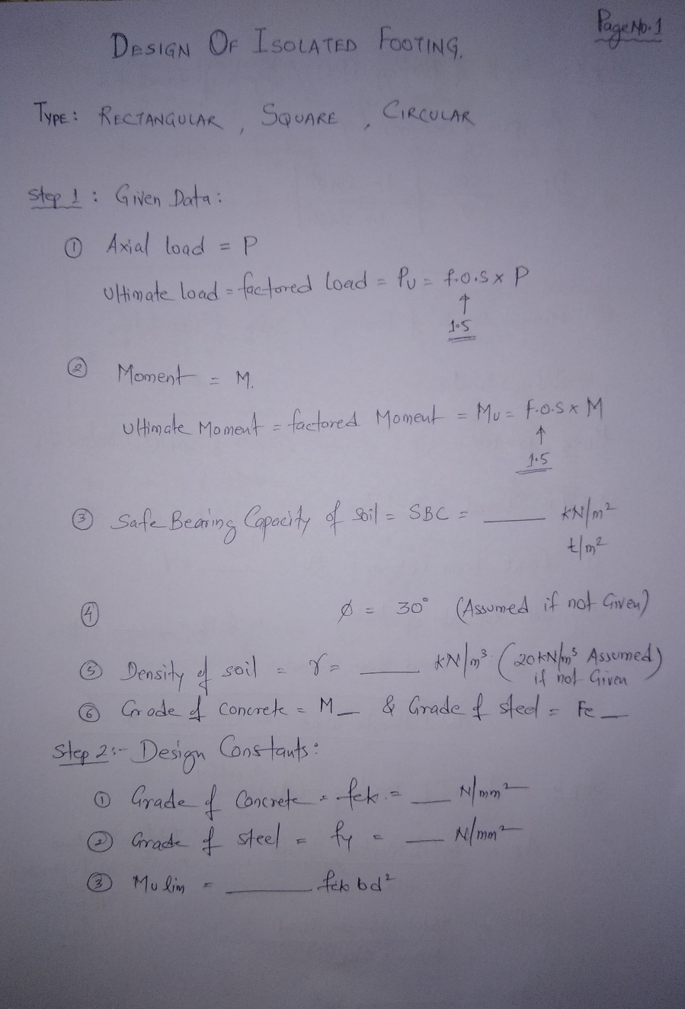
ADVANCED CONCRETE STRUCTURES (ACS)
Type = Rectangular
Step1
Pu = 1000kN
Mu = 120kN-m
SBC = 200kN/m²
Ø = 30º
γ = 20kN/m³
Step2
f_{ck} = 20 N/mm²
f_{y} = 415 N/mm²
Mu_{lim} = 0.138*f_{ck}*b*d²
Anjuman College of Engineering & Technology, Nagpur -01
Department of Civil Engineering
VII Semester B.E. Civil (C.B.S)

Slide 5
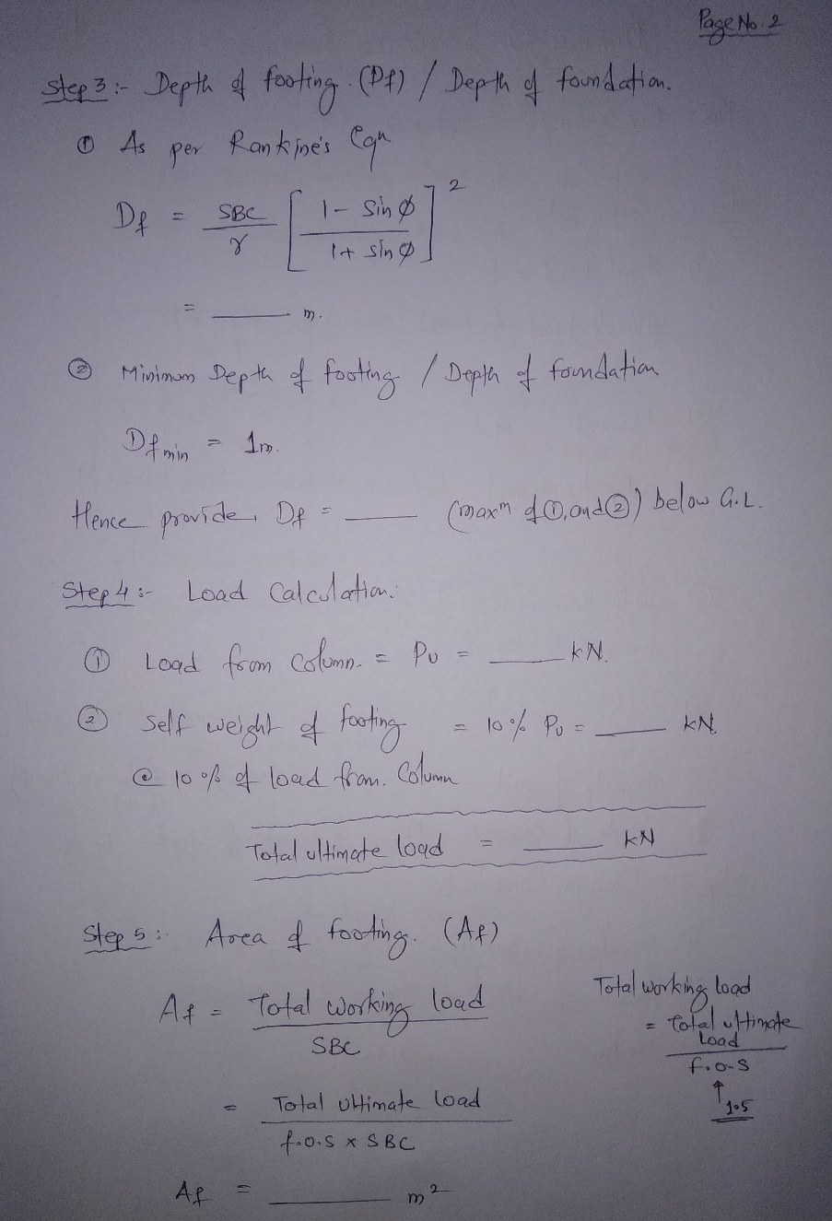
ADVANCED CONCRETE STRUCTURES (ACS)
Step3
1. Df = 1.11m
2. Df = 1.25m
Hence, Df = 1.25m
Step4
1. Pu = 1000kN
2. Self Wt. = 100kN
Total Load = 1100kN
Step5
Af = 3.67m²
Anjuman College of Engineering & Technology, Nagpur -01
Department of Civil Engineering
VII Semester B.E. Civil (C.B.S)

Slide 6
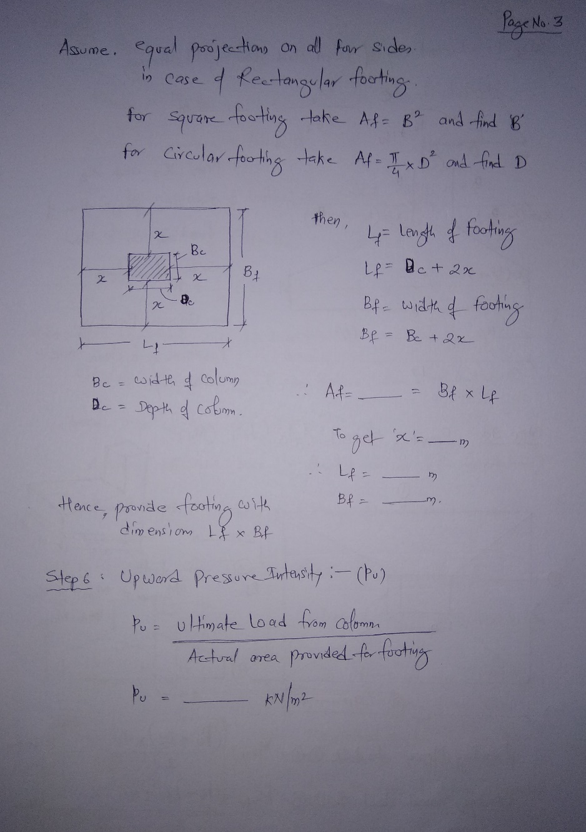
ADVANCED CONCRETE STRUCTURES (ACS)
x = 0.76m
L = 2.1m
B = 1.9m
Step6
p_{u} = 250kN/m²
Anjuman College of Engineering & Technology, Nagpur -01
Department of Civil Engineering
VII Semester B.E. Civil (C.B.S)

Slide 7
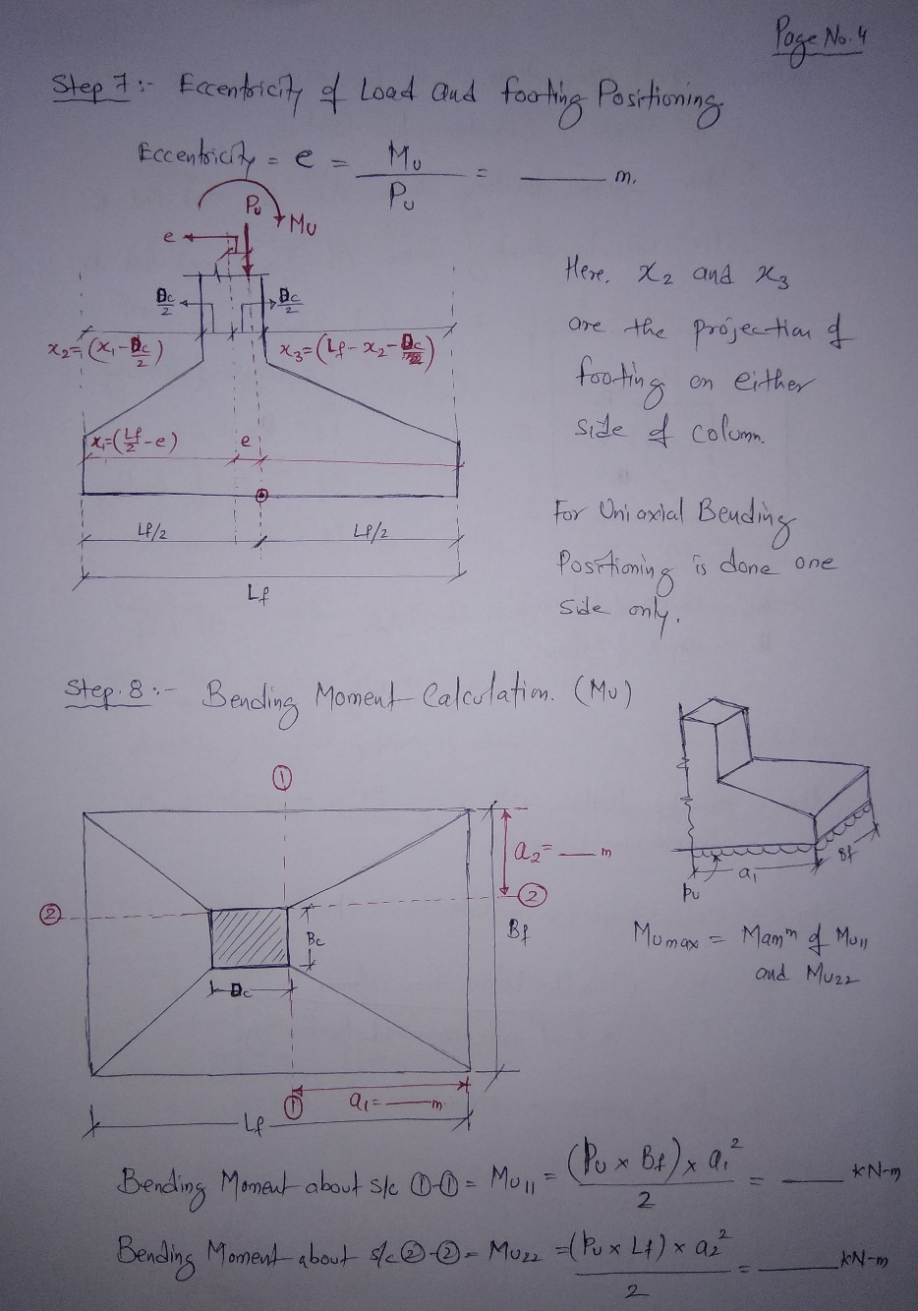
ADVANCED CONCRETE STRUCTURES (ACS)
Step7
e = 120mm
x₂ = 680mm
x₃ = 920mm
Step8
a₁ = 920mm
a₂ = 800mm
Mu₁₁ = 201kN-m
Mu₂₂ = 168kN-m
Anjuman College of Engineering & Technology, Nagpur -01
Department of Civil Engineering
VII Semester B.E. Civil (C.B.S)

Slide 8
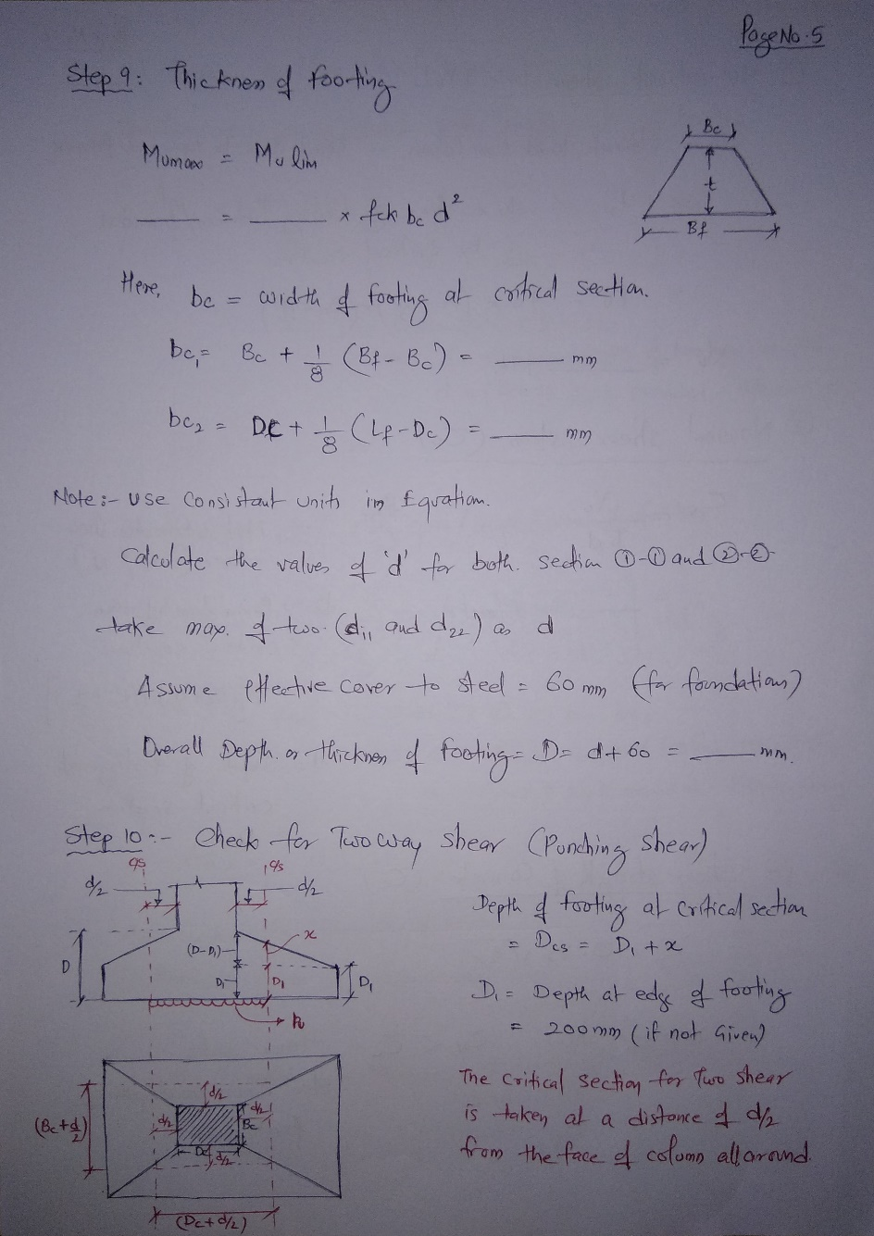
ADVANCED CONCRETE STRUCTURES (ACS)
Step9
bc₁ = 500mm
bc₂ = 700mm
d₂₂ = 323.5mm
d₁₁ = 381.6mm
d = 381.6mm
Effective Cover = 60mm
d = 440mm
D = 500mm
Step10
d/2 = 220mm
x = 228.46mm
D₁ = 200mm
D_{cs} = 428.46mm
Anjuman College of Engineering & Technology, Nagpur -01
Department of Civil Engineering
VII Semester B.E. Civil (C.B.S)

Slide 9
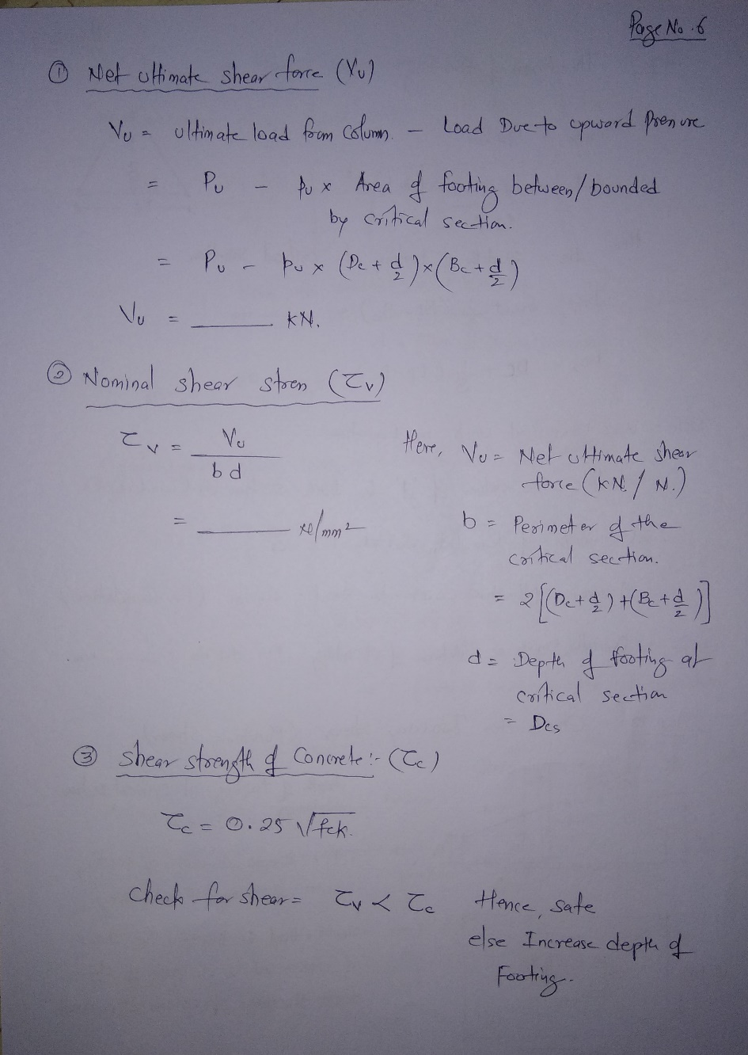
ADVANCED CONCRETE STRUCTURES (ACS)
V_{u} = 826.1kN
τ_{v} = 0.57N/mm²
τ_{c} = 1.11N/mm²
Anjuman College of Engineering & Technology, Nagpur -01
Department of Civil Engineering
VII Semester B.E. Civil (C.B.S)

Slide 10
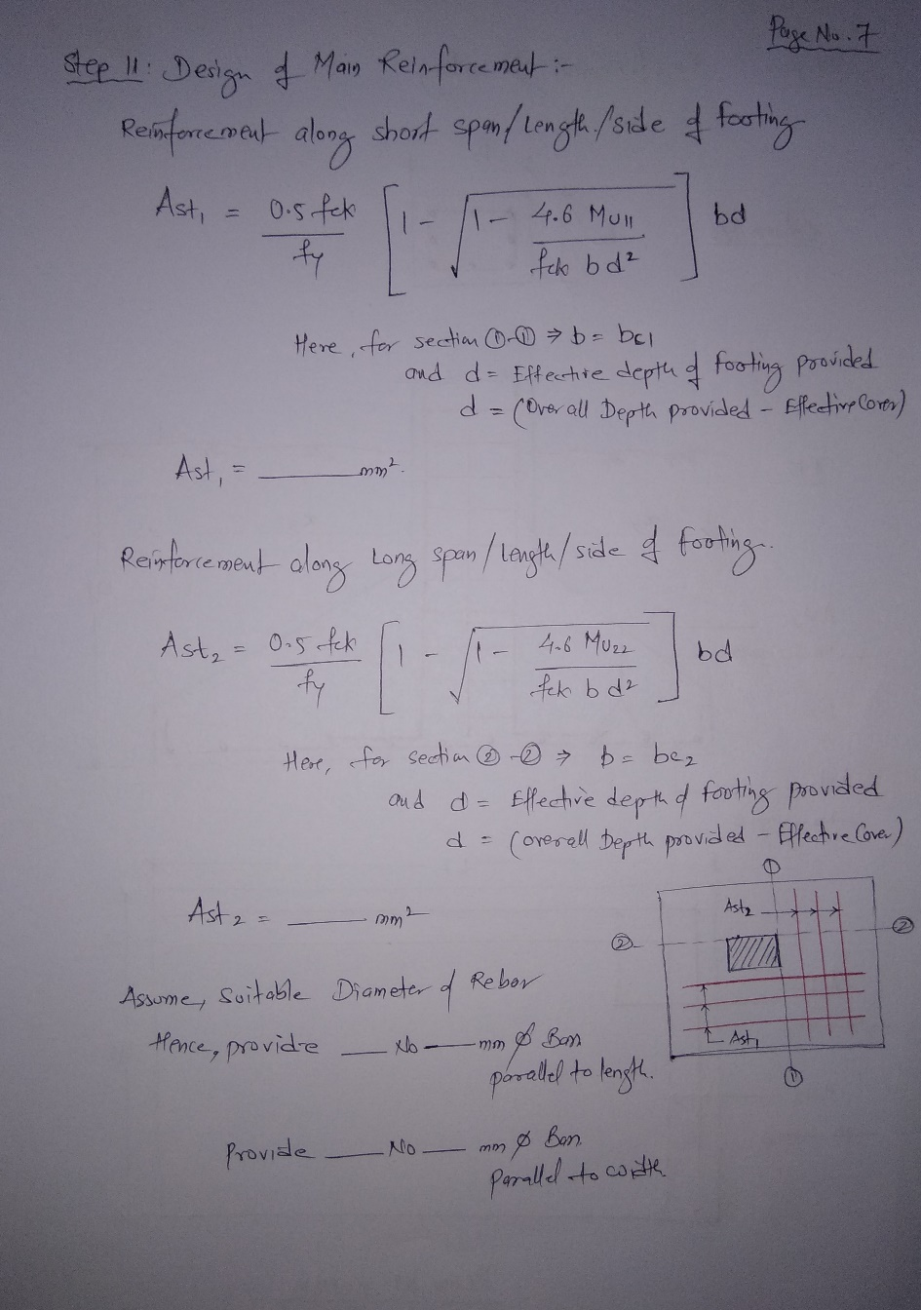
ADVANCED CONCRETE STRUCTURES (ACS)
Step11
d = 440mm
Mu₁₁ = 201kN-m
bc₁ = 500mm
Ast₁ = 1470mm²
Mu₂₂ = 168kN-m
d = 440mm
bc₂ = 700mm
Ast₂ = 1146mm²
Hence Provide,
13-12mm Ø Bars parallel to Length
11-12mm Ø Bars parallel to Width
Anjuman College of Engineering & Technology, Nagpur -01
Department of Civil Engineering
VII Semester B.E. Civil (C.B.S)

Slide 11
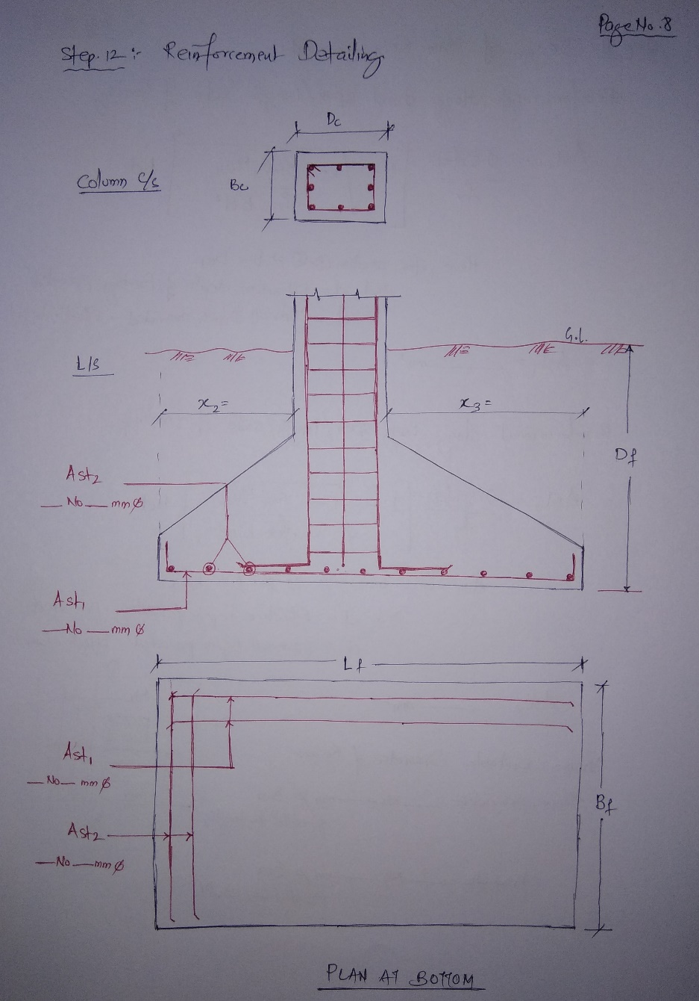
ADVANCED CONCRETE STRUCTURES (ACS)
Step12
Bc = 300 mm
Dc = 500 mm
6-25mm Ø Bars
Df = 1250 mm
x₂ = 680mm
Lf = 2100 mm
x₃ = 920mm
Bf = 1900 mm
Ast₁
13-12mm Ø Bars parallel to Length
Ast₂
11-12mm Ø Bars parallel to Width
Anjuman College of Engineering & Technology, Nagpur -01
Department of Civil Engineering
VII Semester B.E. Civil (C.B.S)

Slide 12
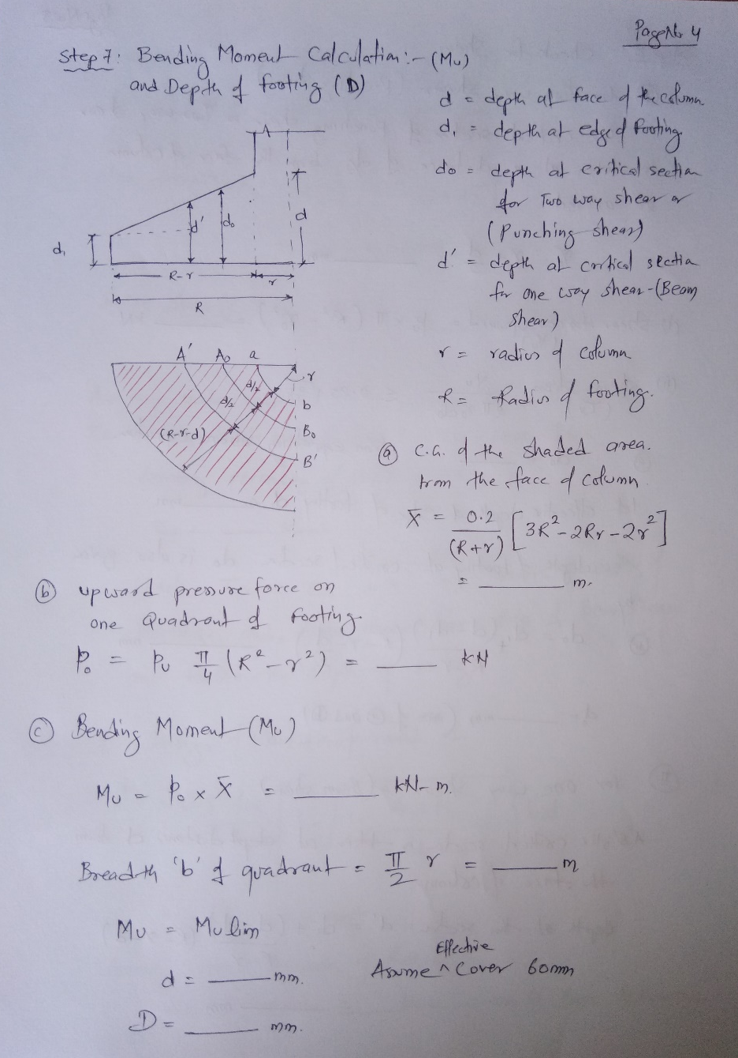
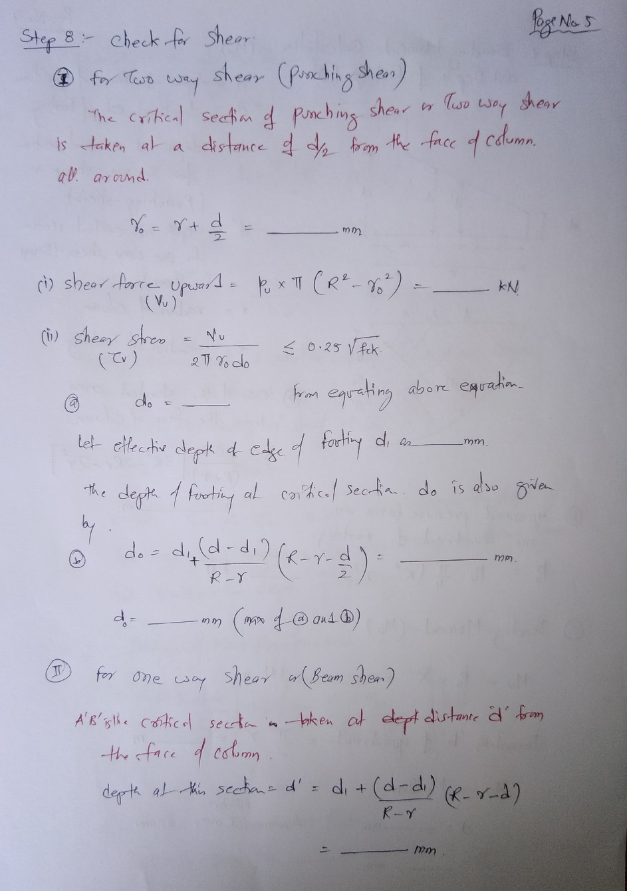
ADVANCED CONCRETE STRUCTURES (ACS)
Anjuman College of Engineering & Technology, Nagpur -01
Department of Civil Engineering
VII Semester B.E. Civil (C.B.S)

Slide 13
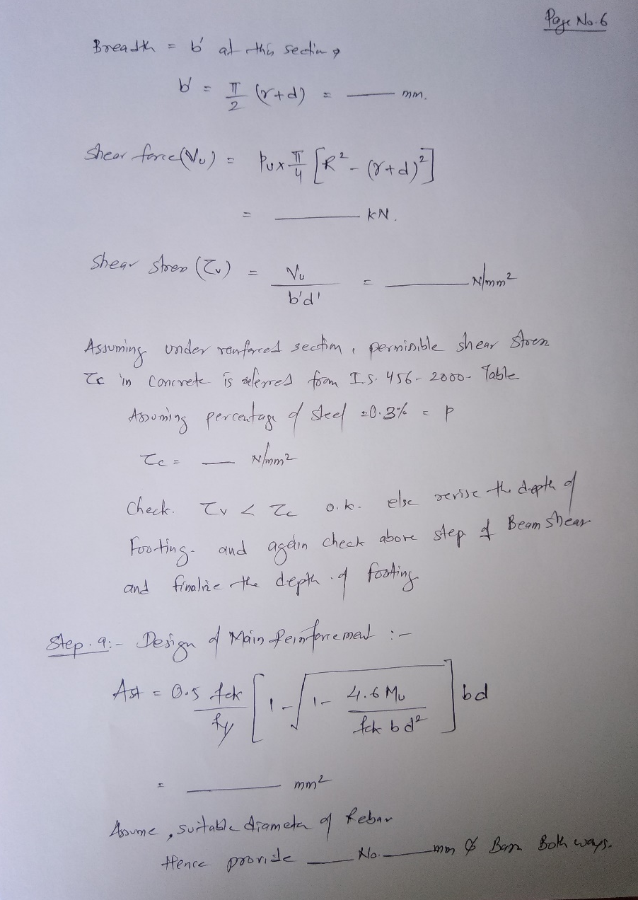
ADVANCED CONCRETE STRUCTURES (ACS)
Anjuman College of Engineering & Technology, Nagpur -01
Department of Civil Engineering
VII Semester B.E. Civil (C.B.S)

Slide 14
ADVANCED CONCRETE STRUCTURES (ACS)
For Square Footing:
1. Design procedure remains same
2. Calculations becomes simpler
For Circular Footing:
1. Design procedure remains same with some changes
2. Calculations becomes simpler
Anjuman College of Engineering & Technology, Nagpur -01
Department of Civil Engineering
VII Semester B.E. Civil (C.B.S)

Slide 15
ADVANCED CONCRETE STRUCTURES (ACS)
THANK YOU
Anjuman College of Engineering & Technology, Nagpur -01
Department of Civil Engineering
VII Semester B.E. Civil (C.B.S)

